Slide 1
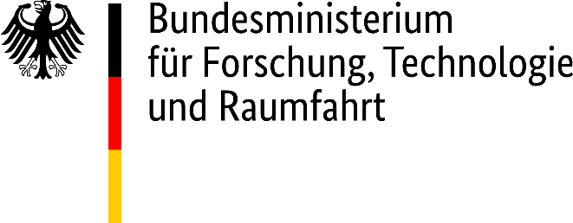

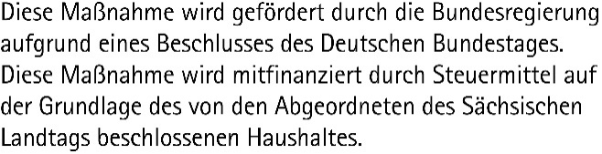
Data Science and AI for Medicine Training School
TRAINING: Application of Deep Learning in Medical Imaging (Radiology)
SPEAKERS: Leo Misera, Asier Rabasco
Training: Application of Deep Learning in AI (Radiology)

Slide 2
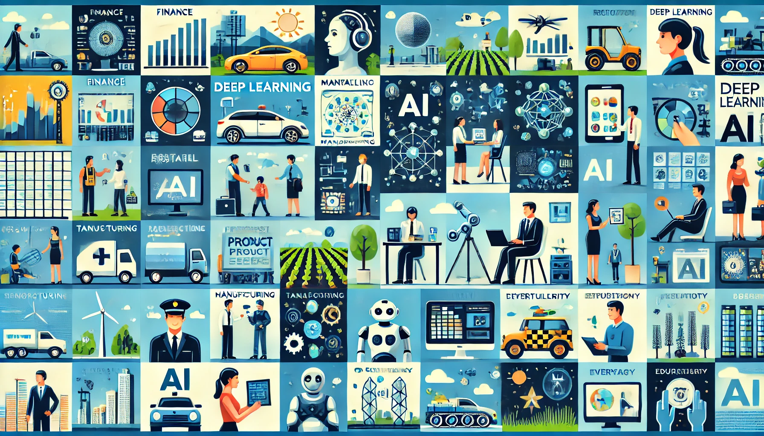
Deep Learning is everywhere…

Slide 3
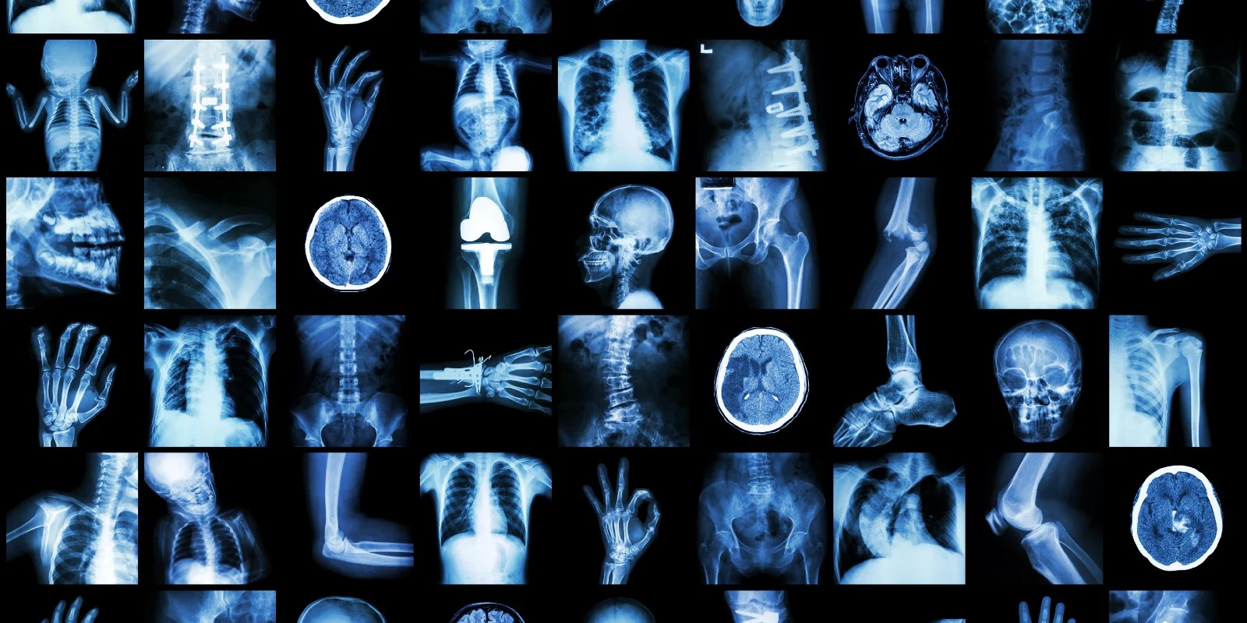
And so is Radiology!

Slide 4
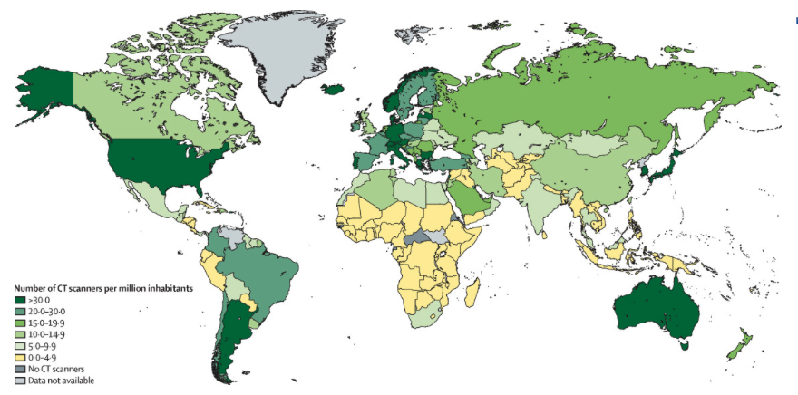
Radiology in Medicine: how every is everywhere?
CT scan maps from Hricak et al. The Lancet Oncology (2021). 22(4): E136-E172
Training: Application of Deep Learning in AI (Radiology)

Slide 5
Radiology in Medicine
Imaging modalities
Applications of Radiology in AI
Hands-On Session
Training: Application of Deep Learning in AI (Radiology)

Slide 6
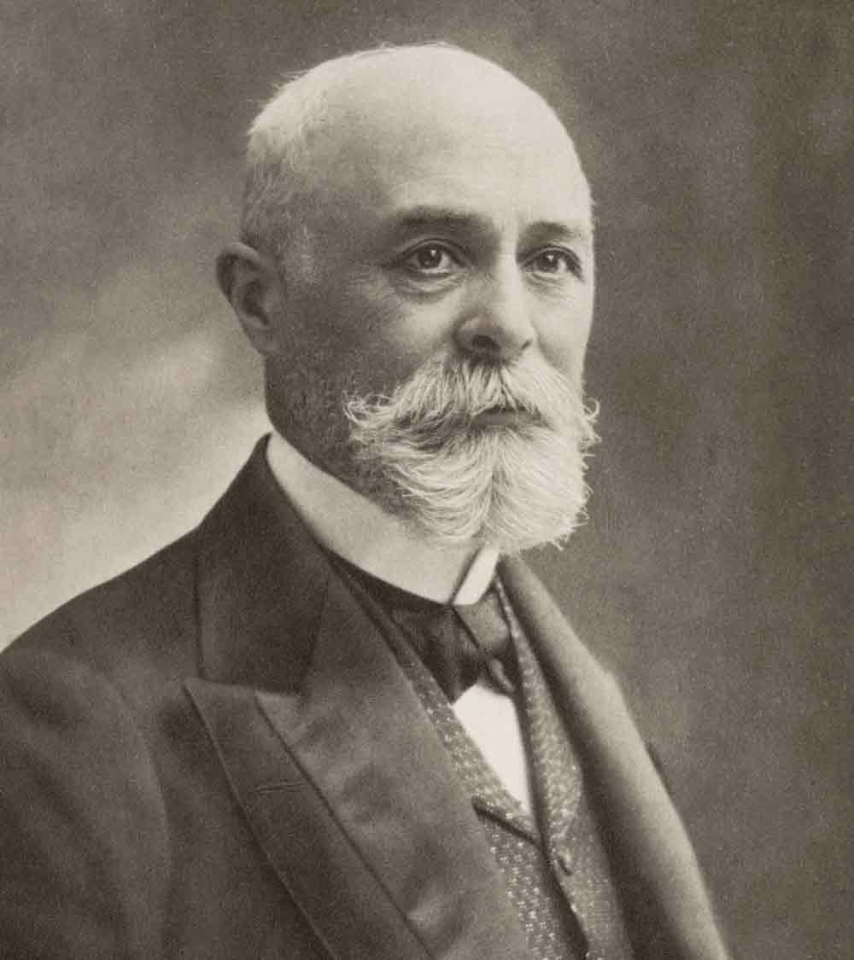
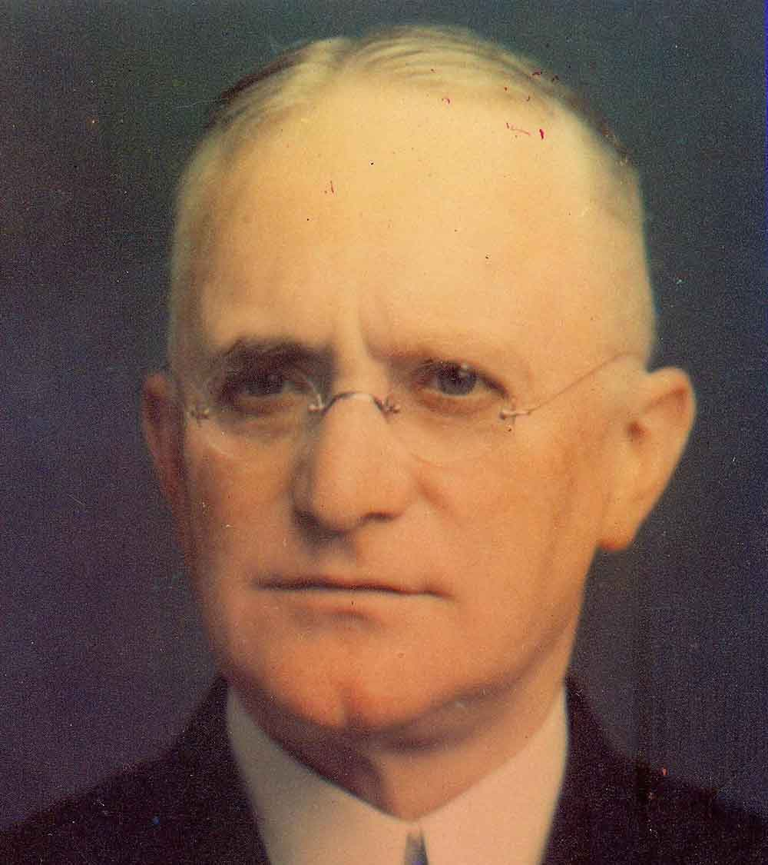
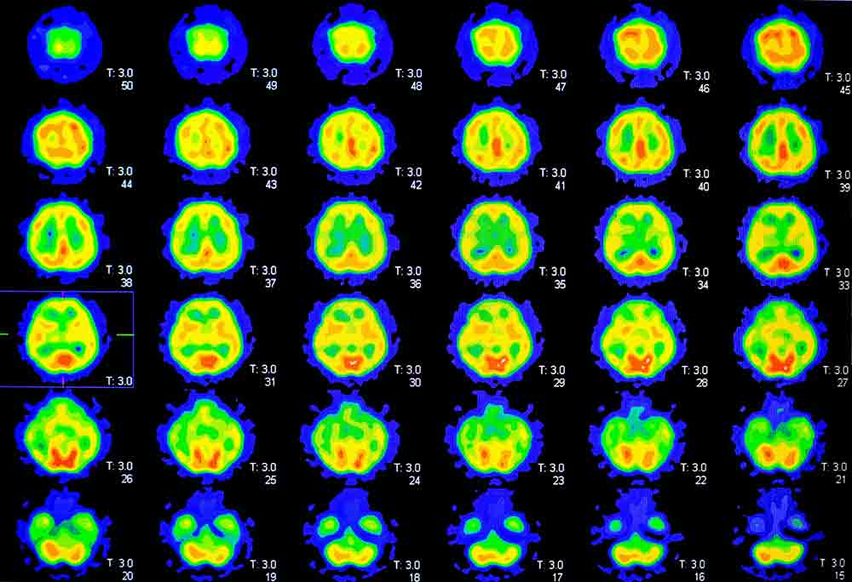
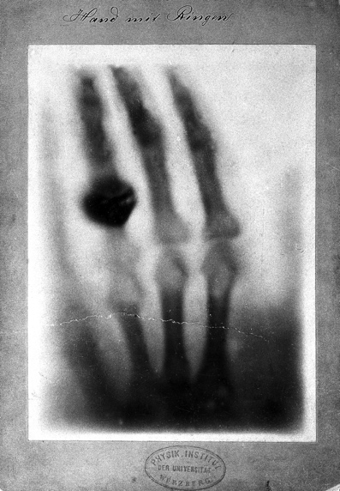
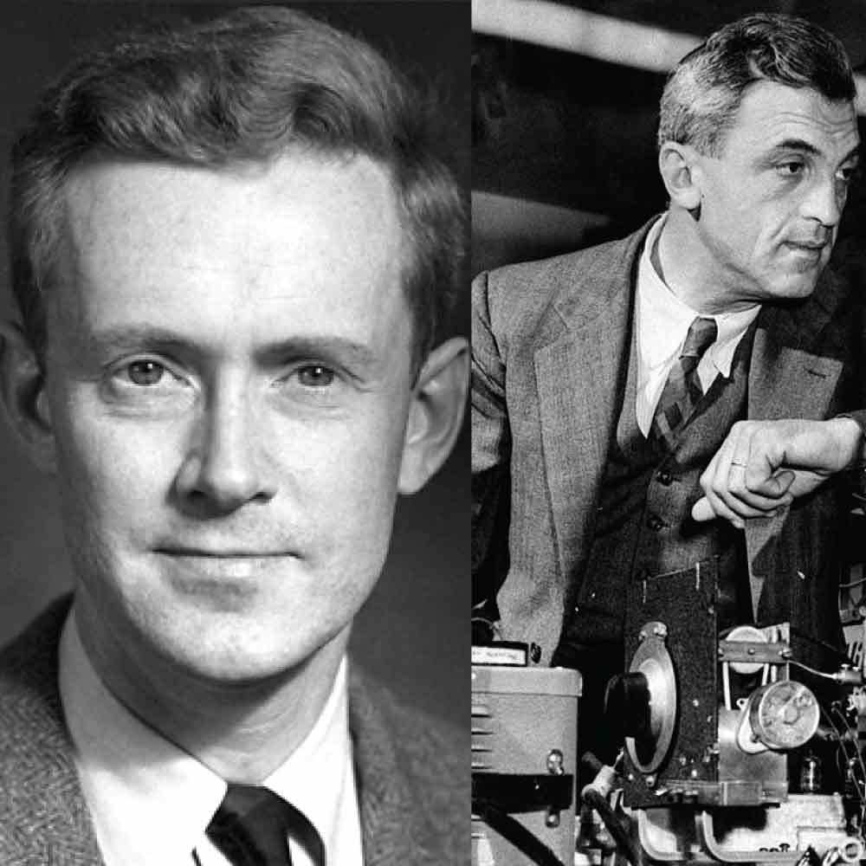
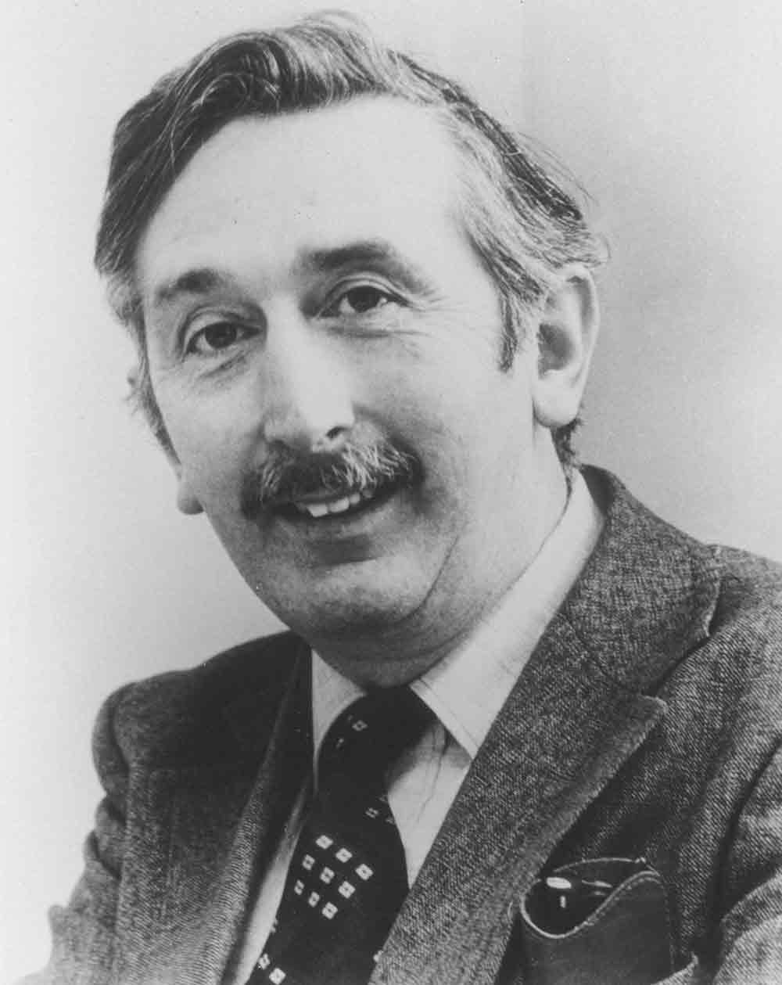
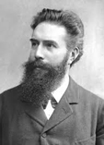
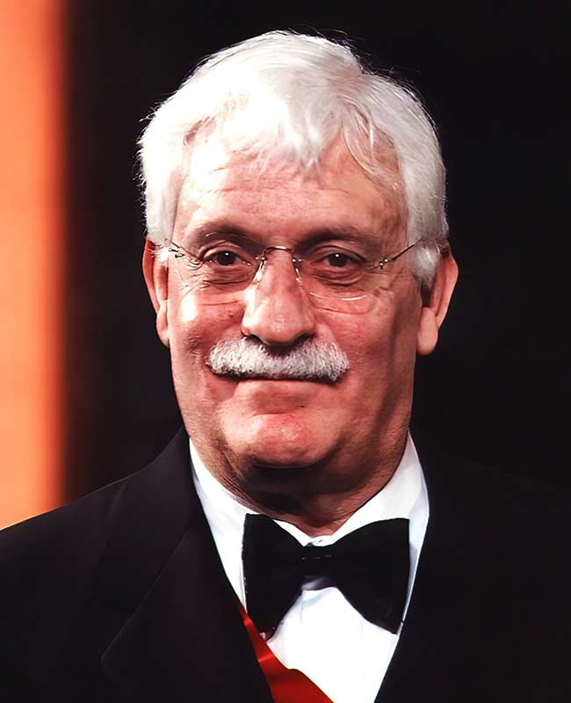
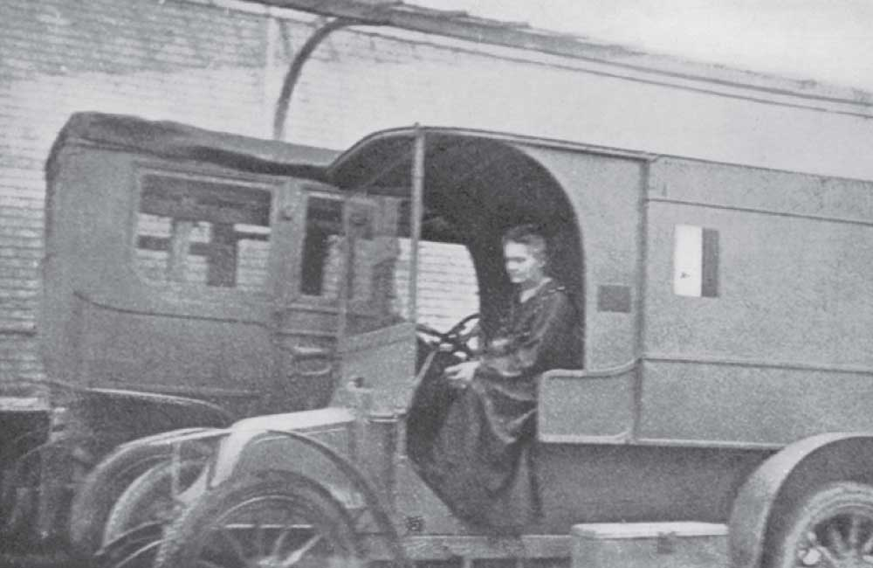
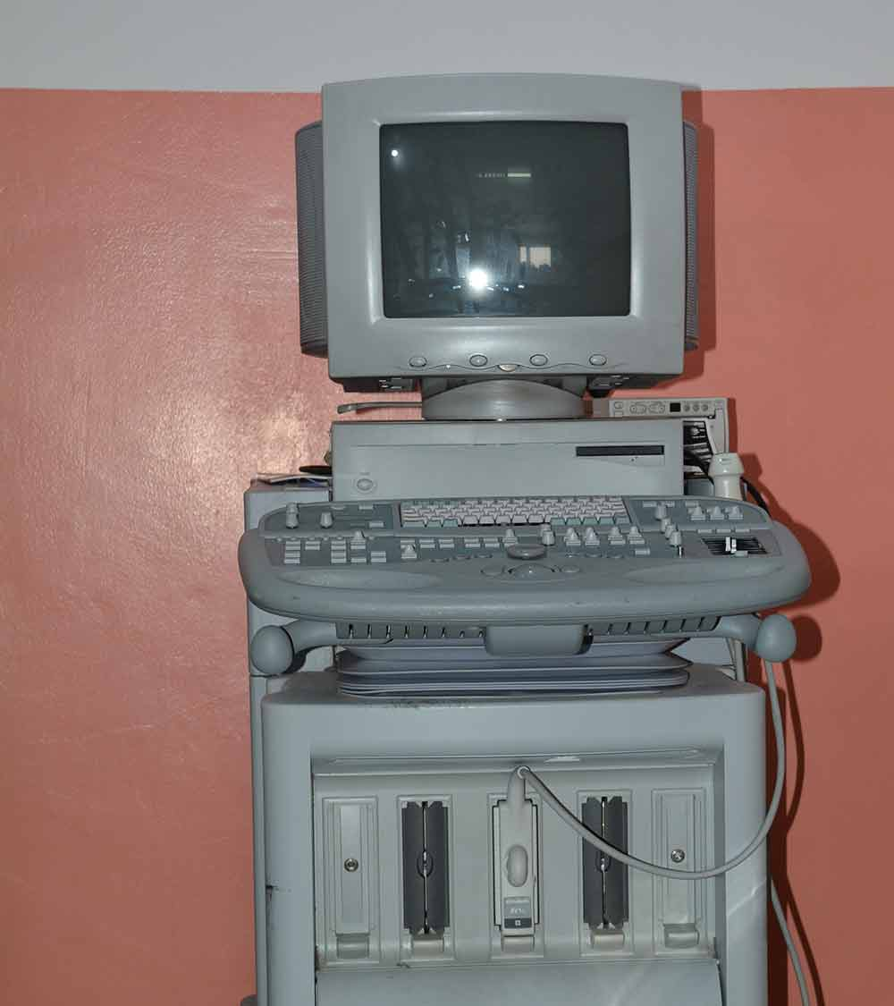
Radiology in Medicine: history and definition
Radiology: leverage of human body imaging for treatment guidance and diagnosis
1895-1896
Discovery of X-rays
and
radioactivity¹
1914-1918
Film used for radiology
Usage in WWI
1946-1958
Discovery of NMR
Usage of ultrasound in gynecology
1970s-1980s
First CT and MRI images
1990s+
Refinement of radiological technologies²
X-rays source:
Röntgen, Wilhelm “A new type of Ray”,1895
FMRI photo:
Belliveau et al. 1991, Science ,254(5032): 716-9
Training: Application of Deep Learning in AI (Radiology)

Slide 7

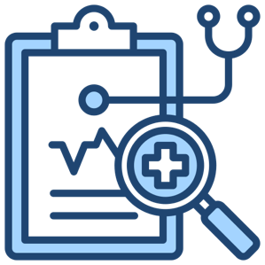
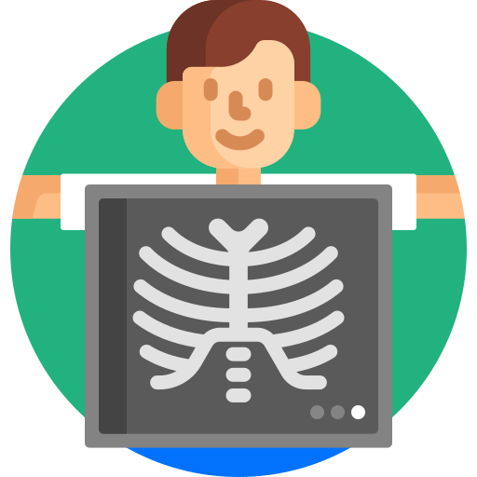

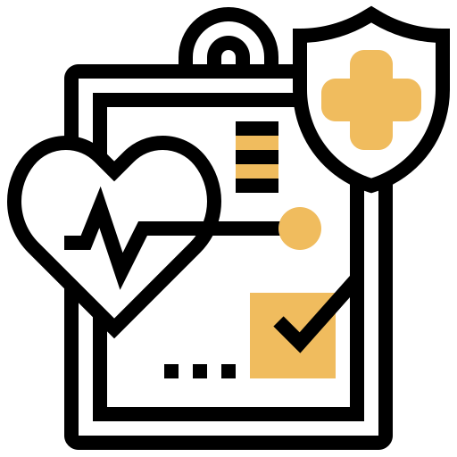



Radiology in Medicine: subtypes
Non-invasive
Diagnostic
Radiology
Direct radiologist
involvement
Produces reports
Guidance of
concurrent procedures
Indirect radiologist
involvement
Interventional
Radiology
Sedation
Training: Application of Deep Learning in AI (Radiology)

Slide 8
Radiology in Medicine
Imaging modalities
Applications of Radiology in AI
Hands-On Session
Training: Application of Deep Learning in AI (Radiology)

Slide 9
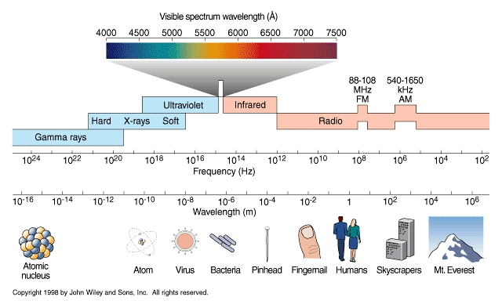

Imaging modalities: brief summary of radiation
Radiation: emission/transmission of energy through space via waves or particles
Ionizing
Non-ionizing
Data for dose of radiation:
US Environmental Protection Agency “Radiation Sources and Doses” https://www.epa.gov/radiation/radiation-sources-and-doses
Training: Application of Deep Learning in AI (Radiology)

Slide 10
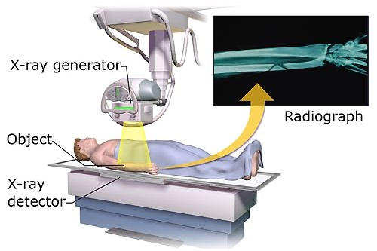
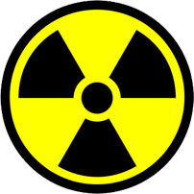



Imaging modalities: projectional radiography
X-rays are ionising sources of radiation.
Small doses used to produce 2D images of body structures
Contrast can be limited due to overlapping of structures in one single view
Radiography is used to diagnose broken bones, foreign objects in soft tissue or screen for infections
Oldest and most used form of medical imaging
Training: Application of Deep Learning in AI (Radiology)

Slide 11
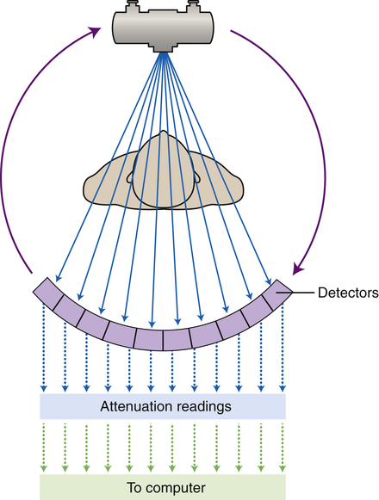
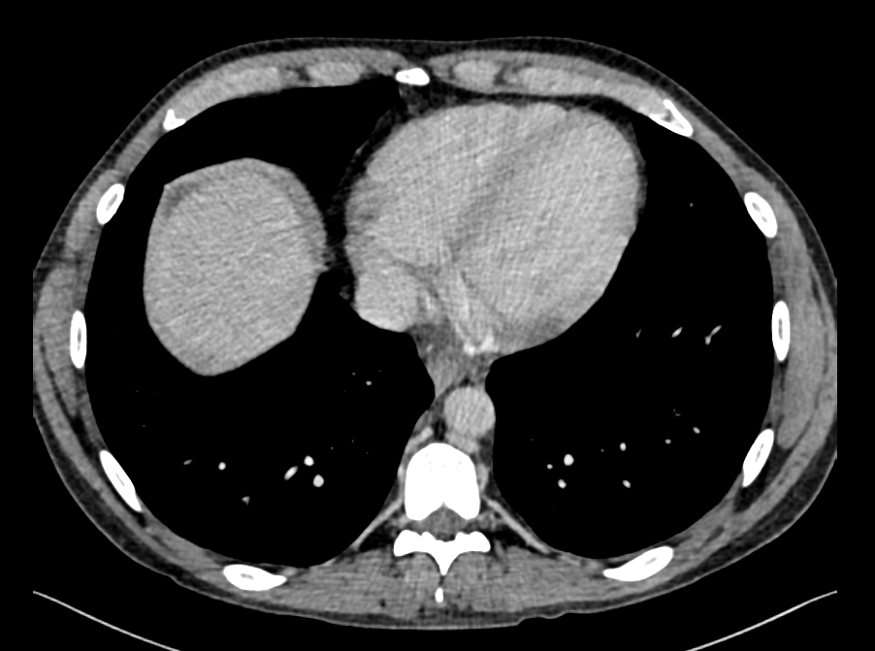
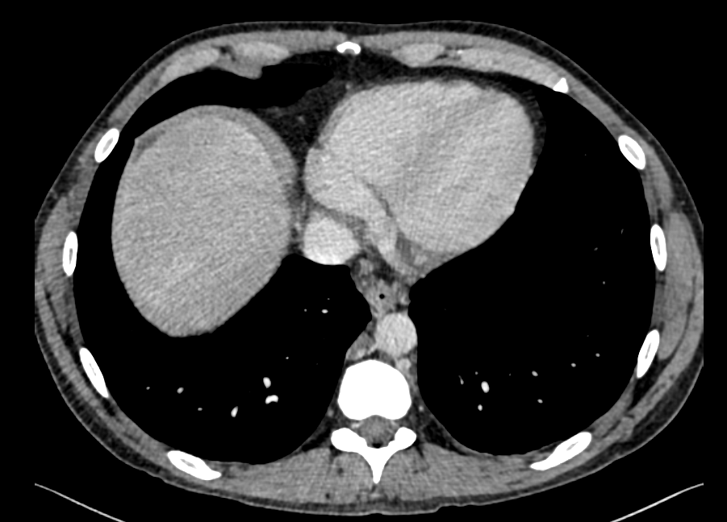
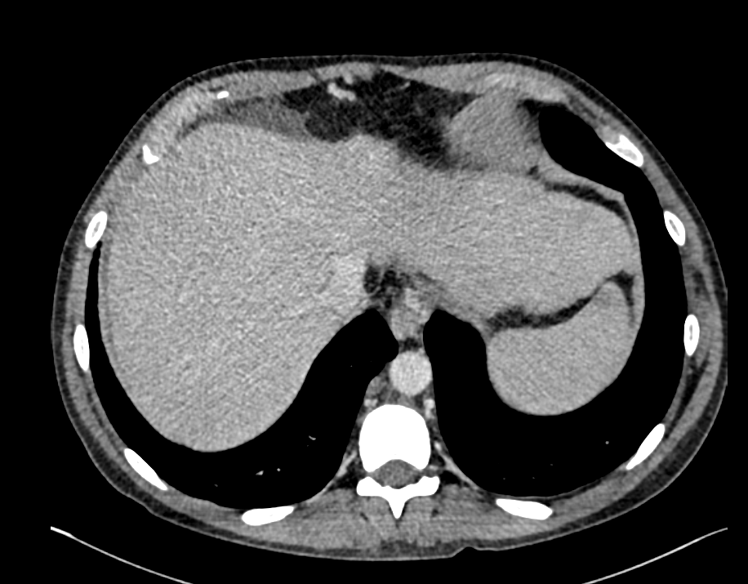
Imaging modalities: computerised tomography
More radiation than X-rays, but allows for 3D scanning of the body/area of interest
Contrast is used intravenously to highlight different parts of the anatomy in real time
Allows for locating lesions within the body, assess sizes and make first impressions on a diagnosis
CT units have physical meaning, related to the attenuation of water.
Training: Application of Deep Learning in AI (Radiology)

Slide 12
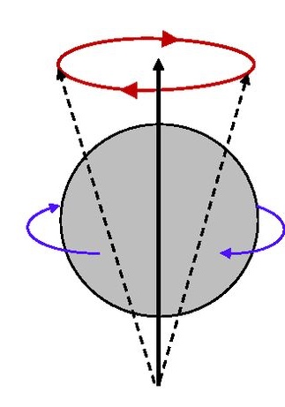

Imaging modalities: magnetic resonance imaging
$\vec{B}$₀
MRI does not produce ionizing radiation, it is based on nuclear magnetic resonance from hydrogen nuclei (protons)
MRI is very very diverse. Sequences use different resonance aspects, highlighting different phenomena
RF pulse
MRIs are better at contrast resolution than CTs but lower at spatial resolution
MRI units are dimensionless and can vary from person to person for the same exam.
Training: Application of Deep Learning in AI (Radiology)

Slide 13
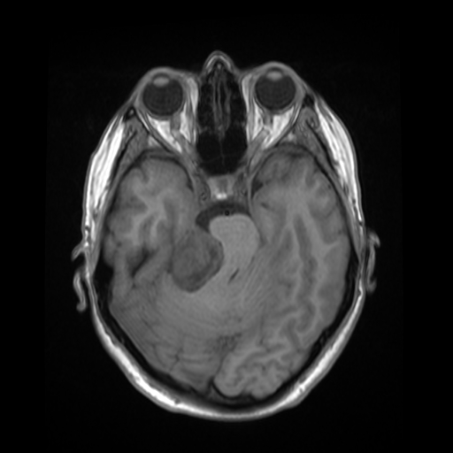
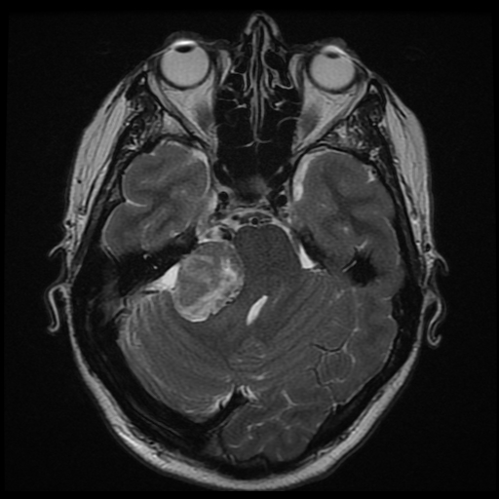
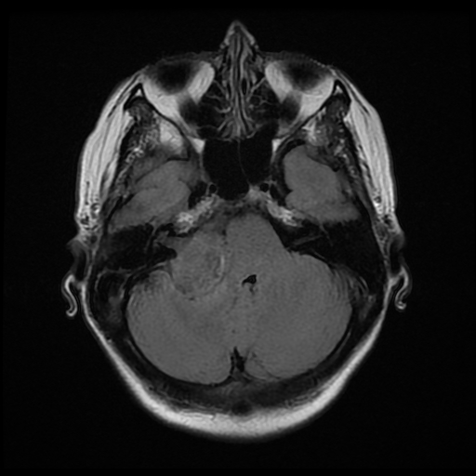
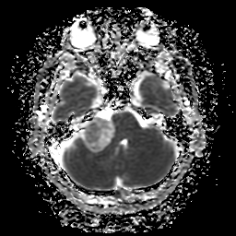
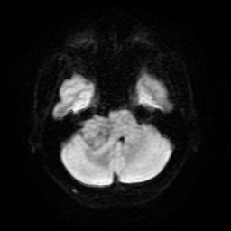
Imaging modalities: magnetic resonance imaging
T1-weighted
T2-weighted
FLAIR
Apparent diffusion
weighted
Diffusion-weighted
Case courtesy of Frank Gaillard, Radiopaedia.org, rID: 28272
Training: Application of Deep Learning in AI (Radiology)

Slide 14
Radiology in Medicine
Imaging modalities
Applications of Radiology in AI
Hands-On Session
Training: Application of Deep Learning in AI (Radiology)

Slide 15
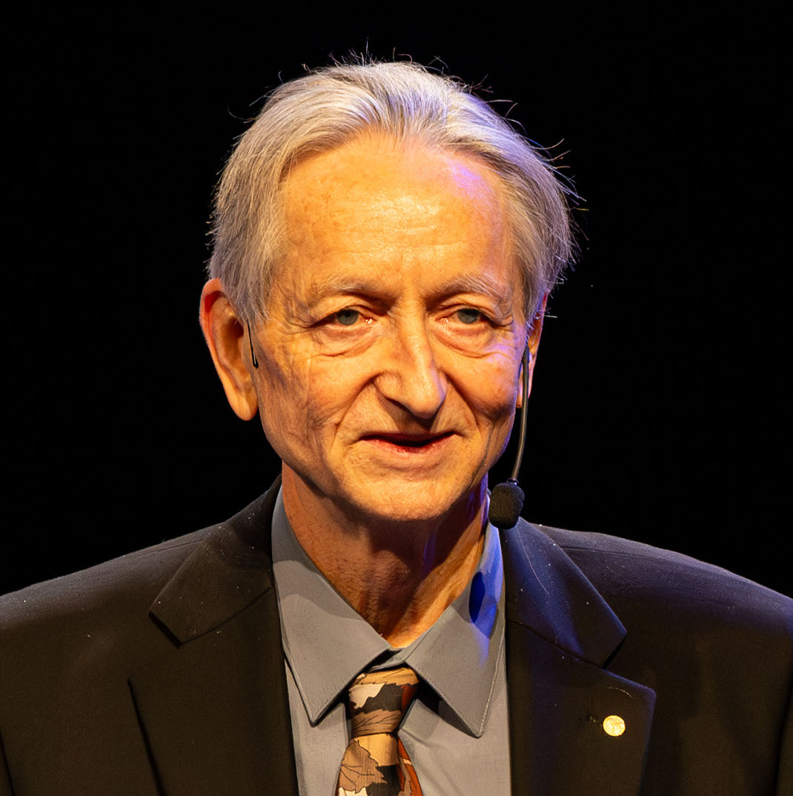
Applications of Radiology in AI
“Radiologists will be obsolete in 5 years”
George Hinton, 2016, Godfather of AI and Nobel prize in Physics.
Not a radiologist
Training: Application of Deep Learning in AI (Radiology)

Slide 16
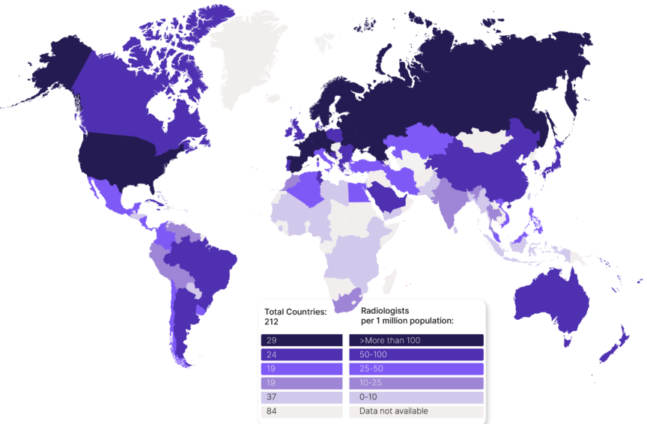
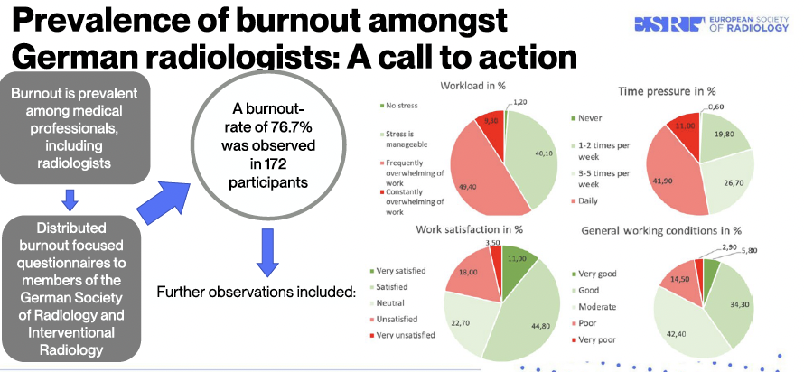
Applications of Radiology in AI: the need for AI
Map of radiologsists from: https://harrison.ai/news
/global-radiology-6-key-challenges-how-ai-can-help/
Burnout abstract:
Bastian, M. et al. European Radiology (2025).
Training: Application of Deep Learning in AI (Radiology)

Slide 17
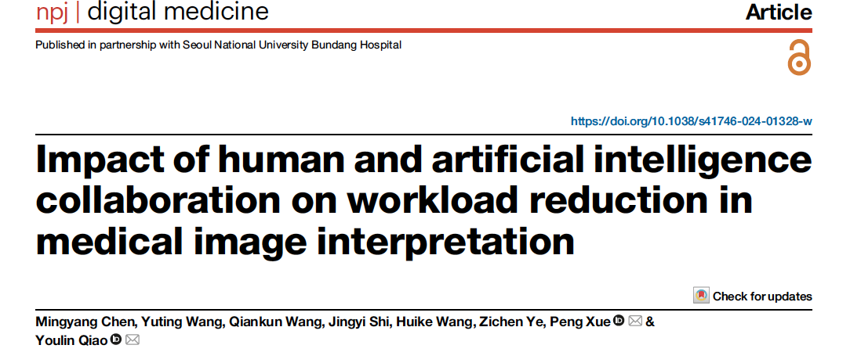
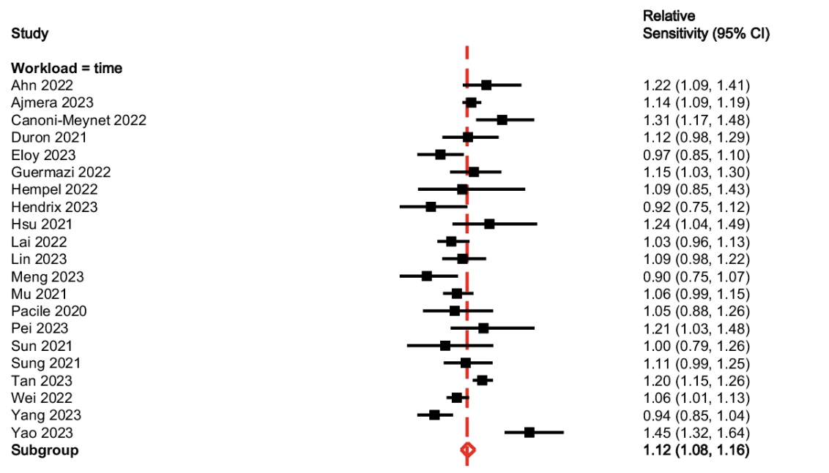
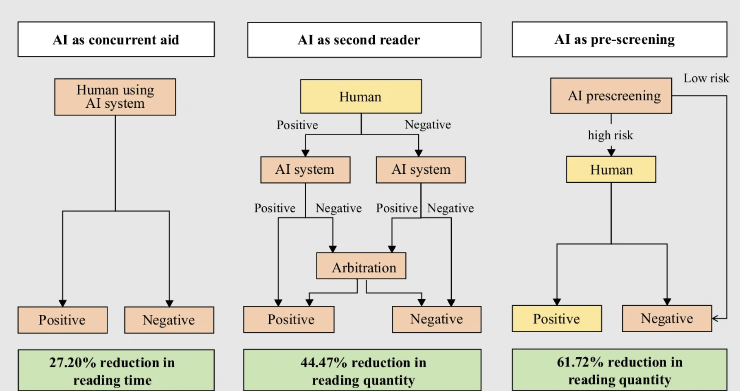
Applications of Radiology in AI: synergistic fields
Training: Application of Deep Learning in AI (Radiology)

Slide 18
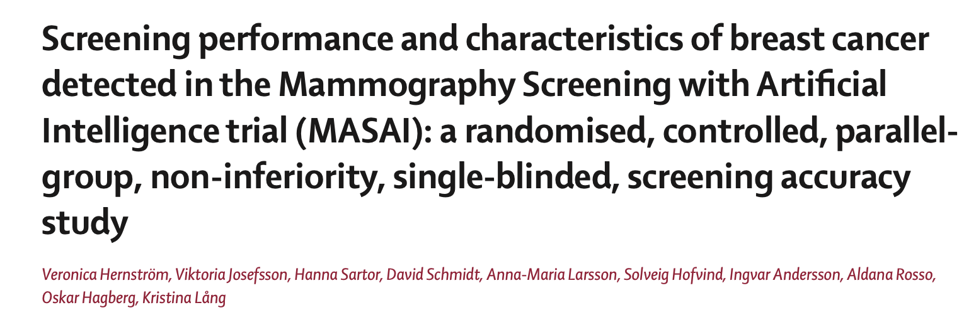
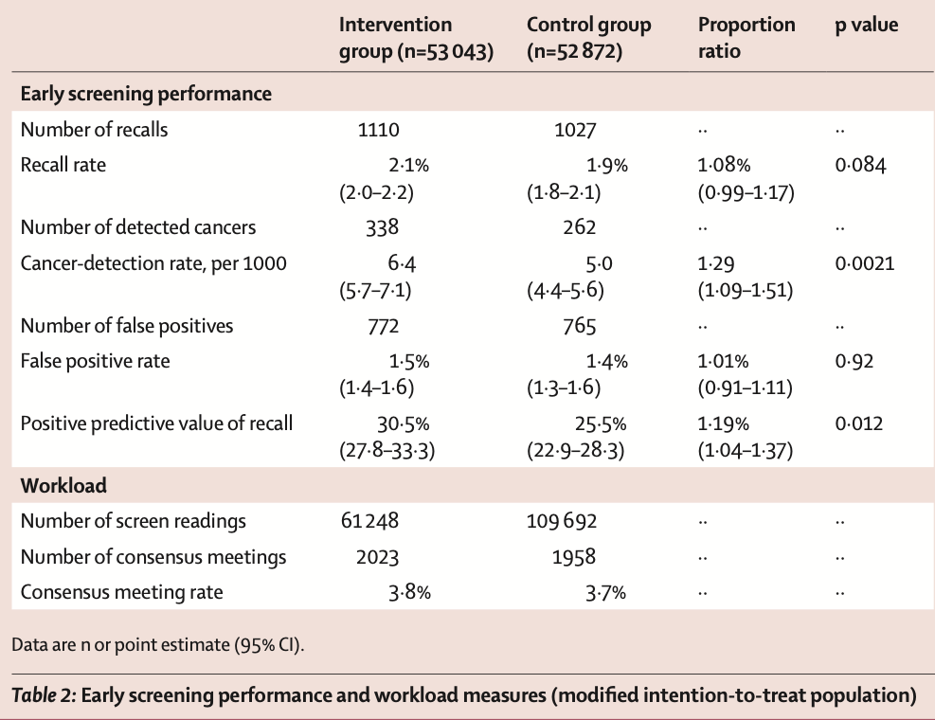
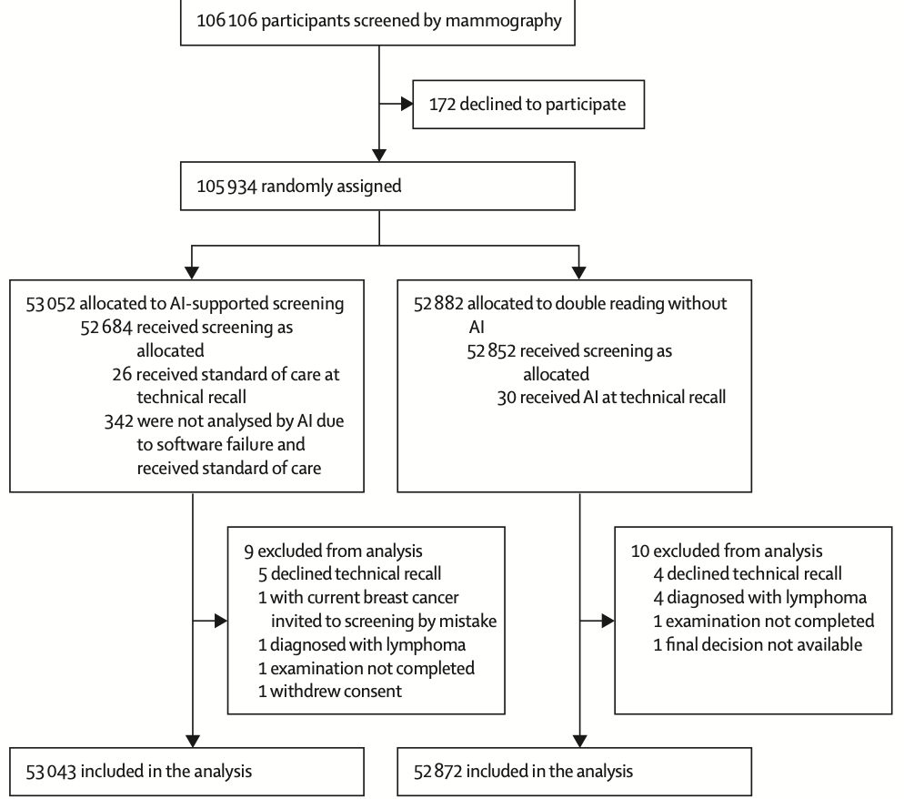
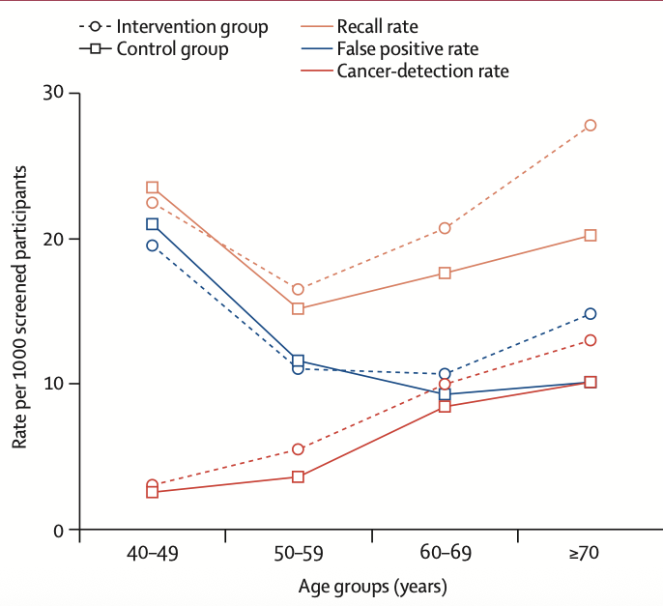
Applications of Radiology in AI: the MASAI trial
Images and data from:
Hernström et al. The Lancet Digital Health (2025). 7(3):E175-E178
Training: Application of Deep Learning in AI (Radiology)

Slide 19
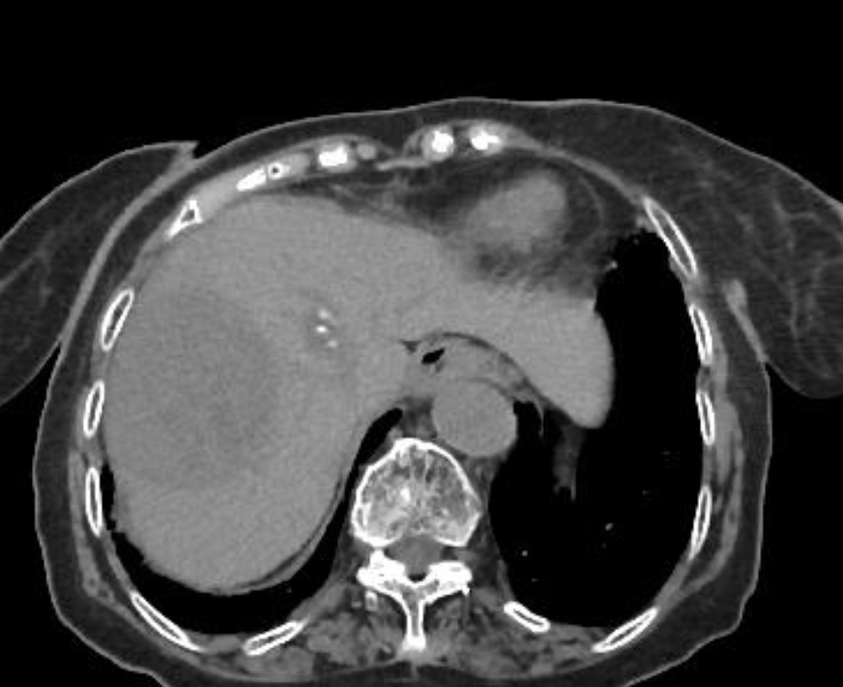
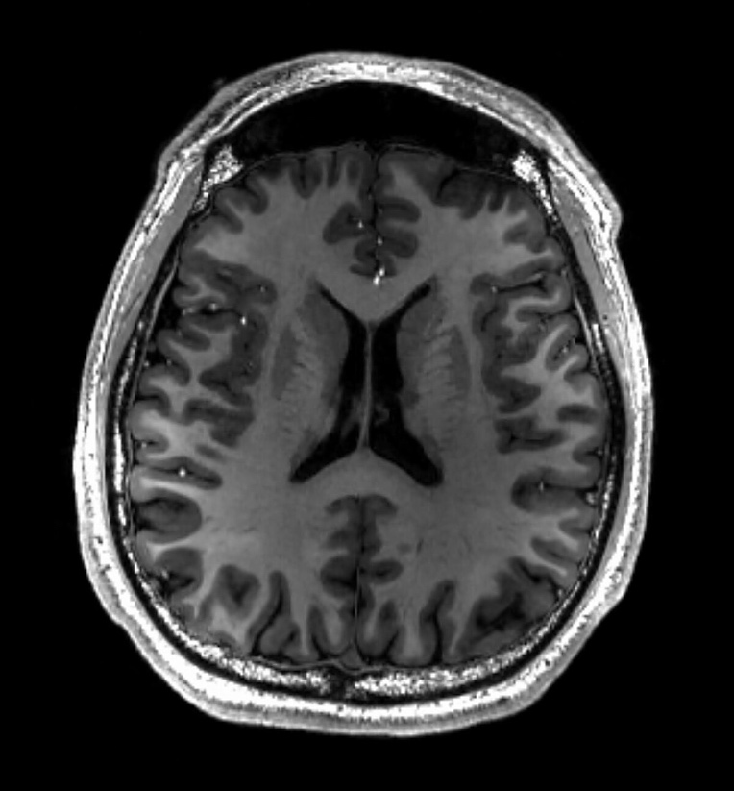
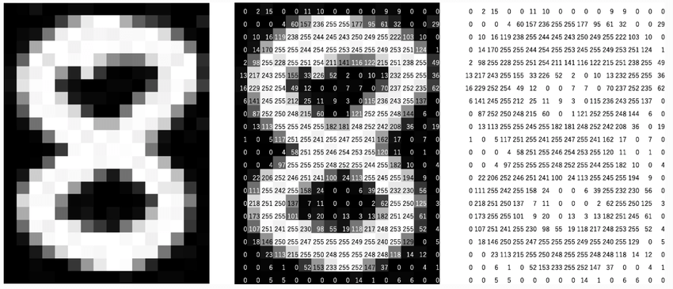
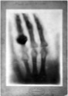


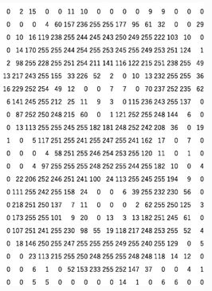
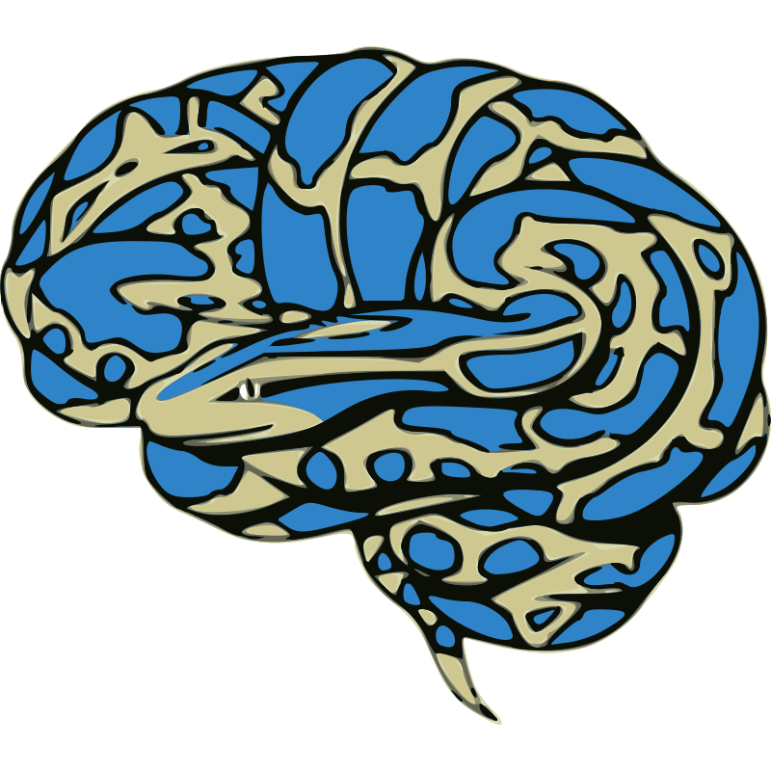




Applications of Radiology in AI: from data to insights
Training: Application of Deep Learning in AI (Radiology)

Slide 20


Applications of Radiology in AI: how is data used?
Data Loading
Package to load images
Functions to feed data to the model
Augmentations on images
Model training
Select parameters for training
Choose architecture
Make loops for training and tracking
Test & evaluate
Use different data to deploy model
Test model through different metrics
Explainability
Radiology dataset
(2D, 3D…)
Training: Application of Deep Learning in AI (Radiology)

Slide 21
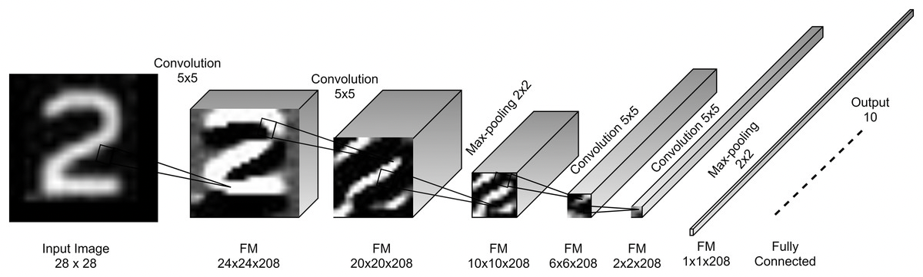
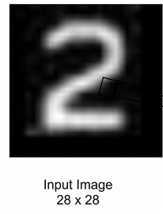
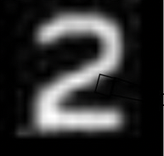
Applications of Radiology in AI: architectures
CNN (Convolutional Neural Networks)
Features based
on relationships of neighbouring pixels through convolution
(Vision) Transformers
Value: actual content of the patch
Key: description of the patch
Query:
What the patch is looking for
Features based on learned relationships between tokens, very weak inductive bias
Training: Application of Deep Learning in AI (Radiology)

Slide 22



Applications of Radiology in AI: explainability
CAM and Grad-CAM
Cam schematix
Dugaecescu et al.. Neural Computing and Applications (2025).
3:14935-14970
X-rays:
Zech, J. et al. PLOS Medicine .(2019). 15(11): e1002683
Training: Application of Deep Learning in AI (Radiology)

Slide 23








Applications of Radiology in AI: segmentation
Segmentation Loss (Dice)
$$L_{dice}=1−\frac{2\sum_{n=1}^{N}{t_{n}y_{n}}}{\sum_{n=1}^{N}{(t_{n}+y_{n})}}$$
Segmentation tool and image of body:
Wasserthal., J. et al. Radiology AI (2023). 5(5)
H&N images: Welch, M et al. (2023).
Computed Tomography Images from Large Head and Neck Cohort (RADCURE)
(Version 4) The Cancer Imaging Archive. https://doi.org/10.7937/J47W-NM11
Training: Application of Deep Learning in AI (Radiology)

Slide 24




Applications of Radiology in AI: prognosis
Images and data from:
Zhange et al. Nature Comms.(2025), 16:4081
Training: Application of Deep Learning in AI (Radiology)

Slide 25
Conclusions
Radiology is a long-lived field with an early adoption of electronic technology
Radiological images are varied and diverse, making Radiology a complex field.
The complexity, number and link of radiological images with diseases makes them a rich source f informative data for modeling
Radiology can benefit from AI, reducing workloads and enhancing radiologist readings
Ai in Radiology is an ongoing field of research. There is evolution in architectures, training styles and applications
Now on to the hands-on session!
Training: Application of Deep Learning in AI (Radiology)

